Slide 1

Logistic Regression
Spring 2020
Financial Informatics

Slide 2
Classification
In classification problems, we are given data as X and labels as y.
Here, we are up to learn a model where, y will be predicted as a function of X.
In classification, the label y is categorical or discrete in value.
For example, suppose you are given many features of a fish, like length, weight, eggs, months and you have to predict whether it is legal to be caught or not. This problem can be formulated as a classification problem.

Slide 3
Data

Slide 4
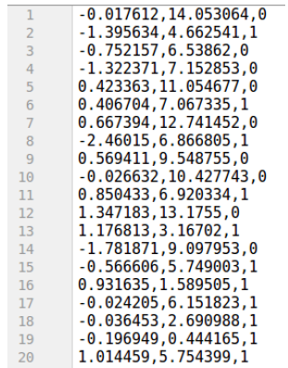
Experiments
x₁
x₂
y
We will first try to predict the class of the dataset based on two features, x₁ and x₂.
Link to data: https://raw.githubusercontent.com/swakkhar/MachineLearning/master/Codes/logistic.csv

Slide 5
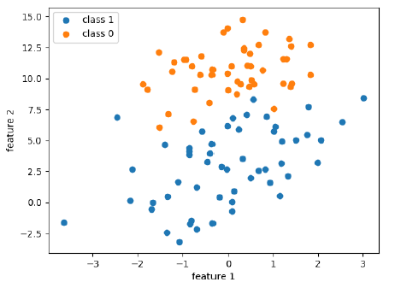
Experiments
We will first try to visualize the class of the dataset based on two features, x₁ and x₂.

Slide 6
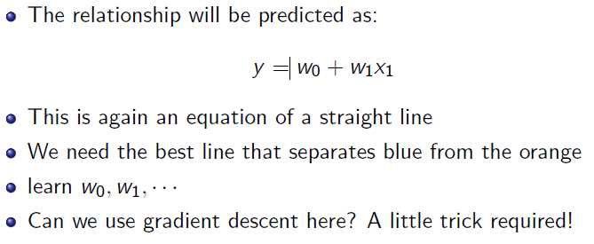
Logistic Regression
At first, we are going to try a linear classier called logistic regression. We can apply logistic regression when the data is linearly separable.

Slide 7
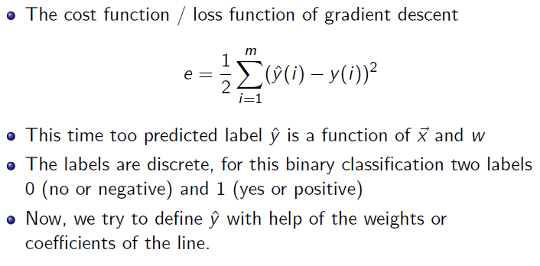
Gradient Descent for Logistic Regression

Slide 8
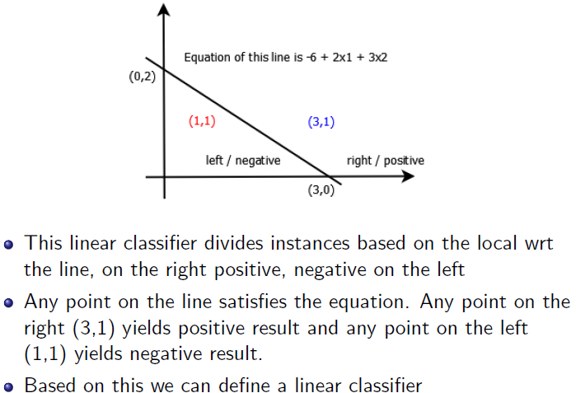
Linear Classification

Slide 9
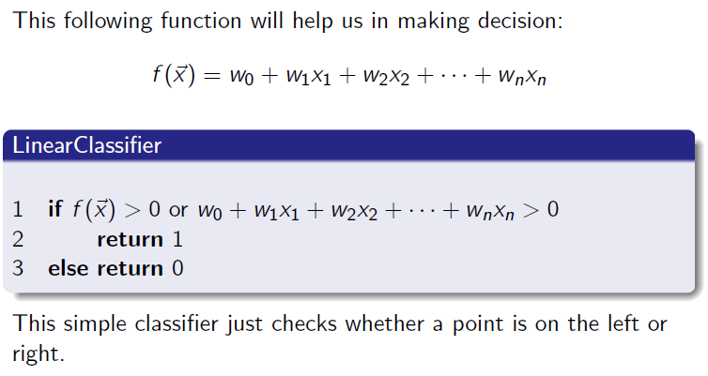
Linear Classification

Slide 10
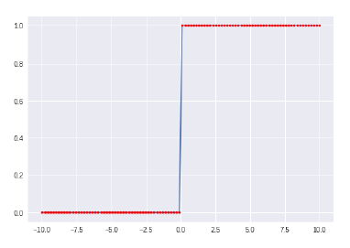
A step function!
Alas! This is not a continuous function and thus not differentiable.
We can't calculate gradients! We need to find an alternate!

Slide 11
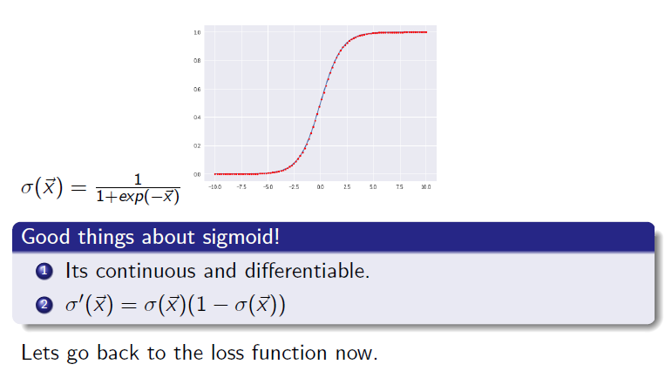
A sigmoid function

Slide 12
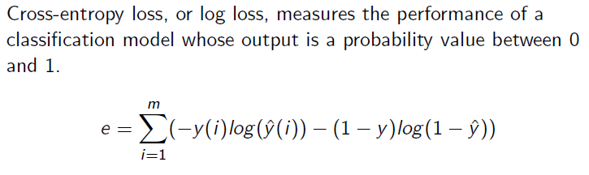
A new loss function - Cross-entropy

Slide 13
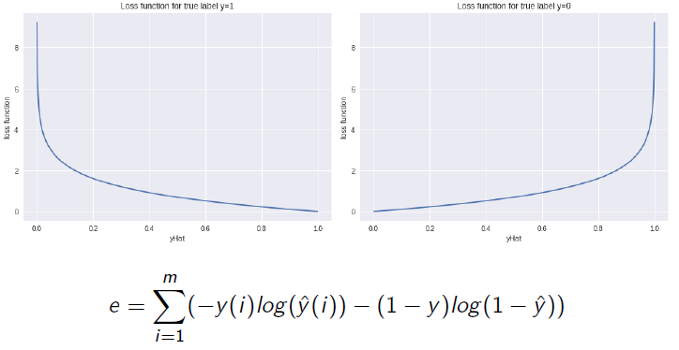
Cross Entropy Loss Function

Slide 14
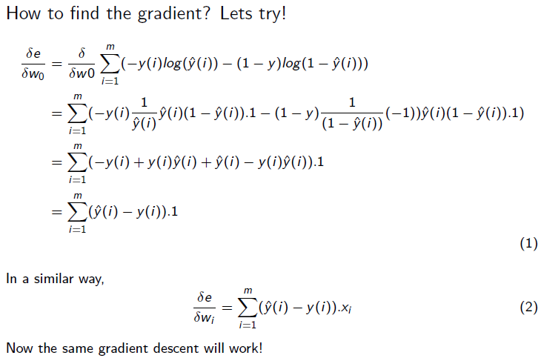
Cross Entropy Loss Function

Slide 15
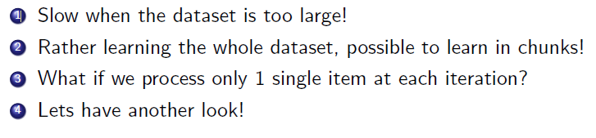
Comments on Gradient Descent

Slide 16
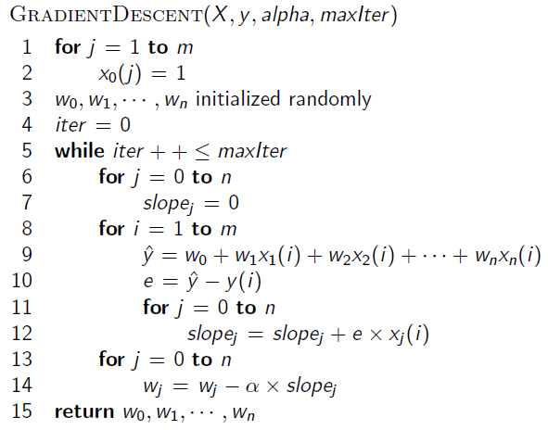
Gradient Descent Algorithm

Slide 17
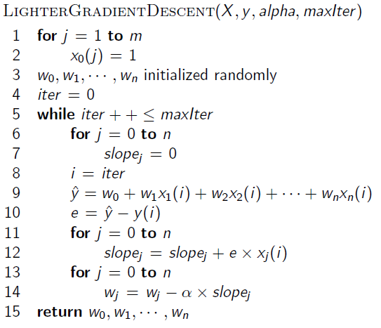
Lighter Gradient Descent Algorithm

Slide 18
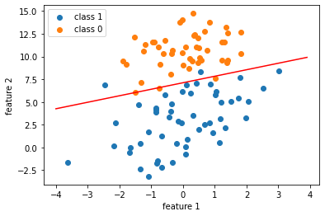
Gradient Descent

Slide 19
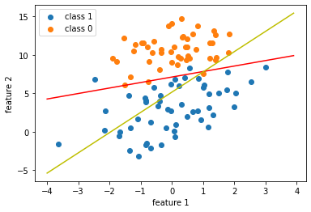
Comparison

Slide 20
Note Book
https://colab.research.google.com/drive/1l4elDzd4hi5THis8Q-VZNT2U4dhboDbS

